Slide 1
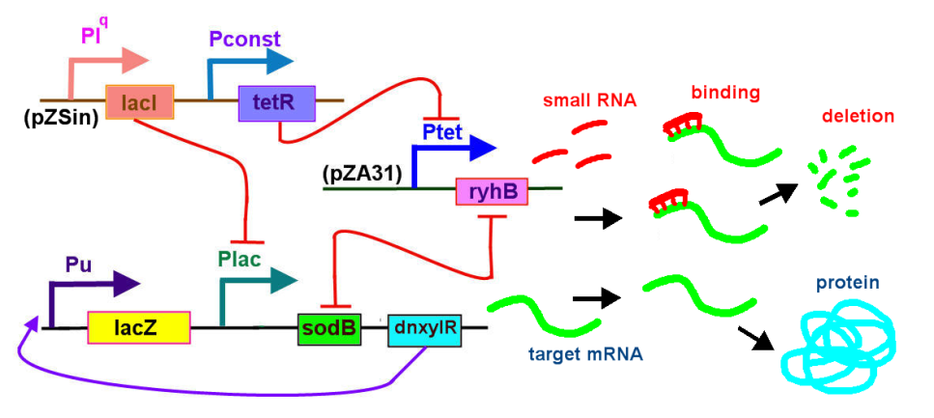
The analysis of regulatory networking with non-coding RNA
Dr. Po-Han Lee (李柏翰)/phlee@narlabs.org.tw
National Applied Research Laboratories, National Center for High-performance Computing Division
----20140409-11-- PRAGMA 26 Workshop----

Slide 2
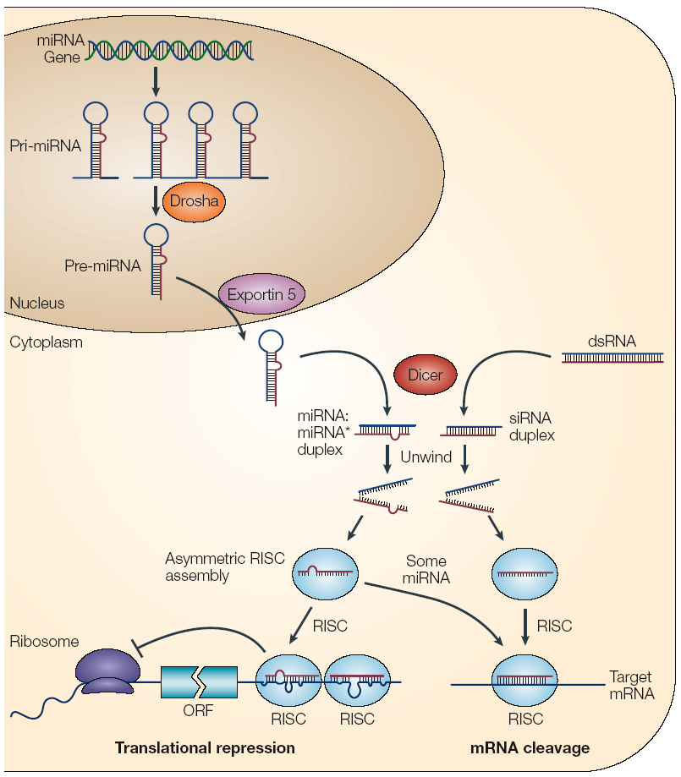
Biogenesis
RNAse III enzymes
Drosha (nucleus)
Dicer (cytoplasm)
Both enzymes involved in the generation of siRNA
RISC = RNA-induced silencing complex (contains miRNPs and Argonaute family proteins)
RISC = Degradation/Silencing?
Notes:
Pre-miRNA= aprox. 70 nucleotides that have the capacity to form stem-loop structures.
These pre-miRNAs are further processed into mature miRNA in the cytoplasm by another RNAse III-like enzyme that is known as Dicer.

Slide 3
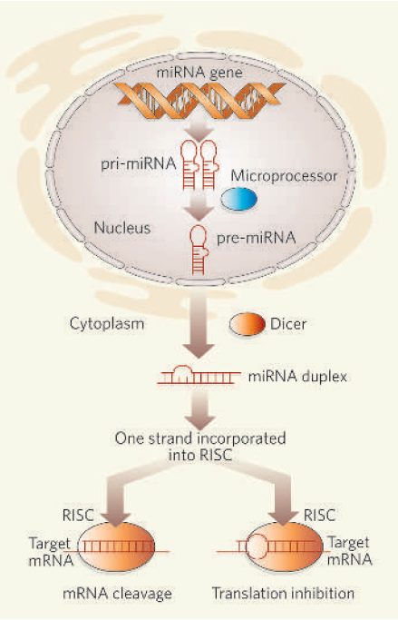
↑ Match with target (degree of complementarity)
= ↑ Prob. of degradation
Possibly each miRNA may target multiple genes
miRNA = or ≠ siRNA ?
Biochemically indistinguishable
Single vs double-stranded
Repression vs degradation?
Post-Transcriptional Gene Silencing (PTGS) versus TransIational Inhibition

Slide 4
Genetic Regulation (protein/small RNA level)
Negative regulation —Protein (repressor) inhibits transcription (Ex. LacI, TetR protein). Inducer– binds to repressor, alters form, reduces affinity for target, allows expression of gene. Sometimes, small molecule required for repressor activity.
Positive regulation —Activator protein increases transcription rate. Generally bound to a smaller signal molecule. (Ex. XylR protein activates Pu promoter).
sRNA-mediated gene silencing -(sRNA) are small (50-250 nucleotide) non-coding RNA molecules produced by bacteria; they are highly structured and contain several stem-loops. sRNAs can either bind to protein targets, and modify the function of the bound protein, or bind to mRNA targets and regulate gene expression. (Ex. RyhB and sodB)

Slide 5
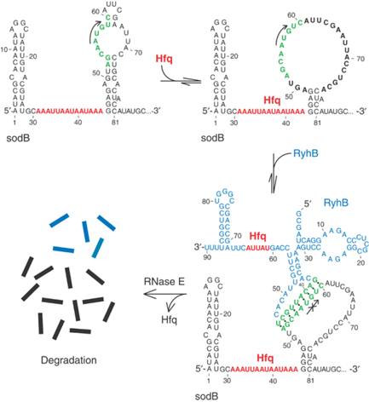
The small RNA RyhB and its sodB
The small RNA RyhB and its sodB (iron superoxide dismutase) mRNA target in E. coli.
RyhB binding blocked the translation initiation codon of sodB and triggered the degradation of both RyhB and sodB mRNA.
RyhB RNA is a 90 nucleotide non-coding RNA regulates a set of iron-storage and iron-using proteins when iron is limiting.
Negatively regulated by the ferric uptake repressor protein, Fur (Ferric uptake regulator).
The EMBO J.23,396 (2004)

Slide 6
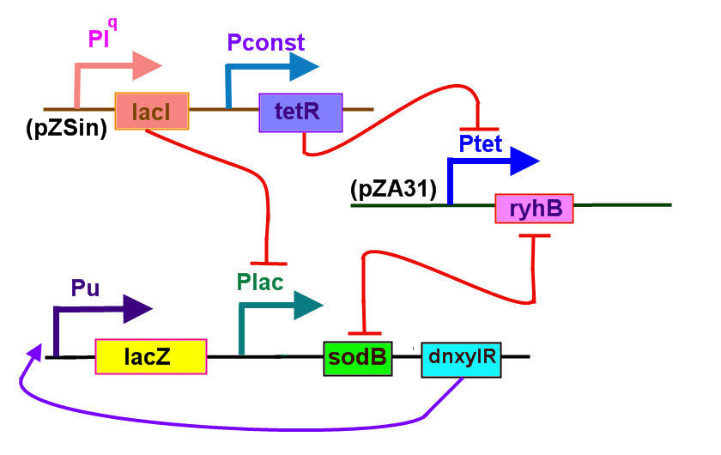
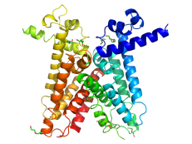
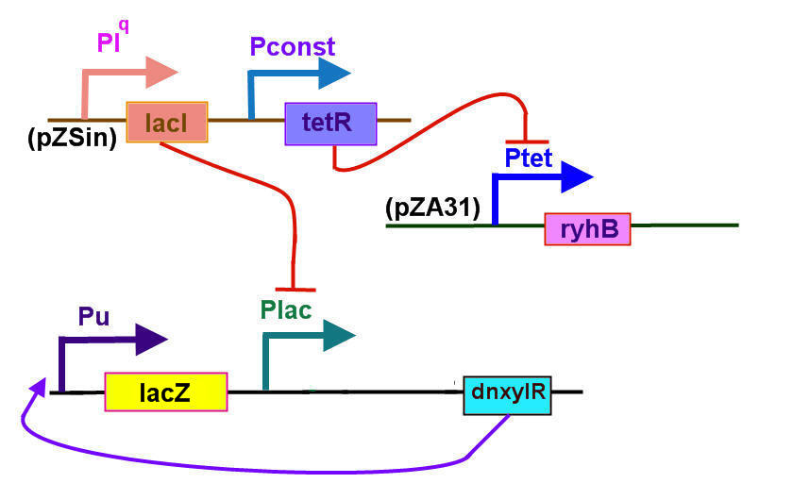
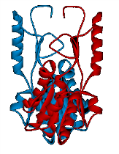
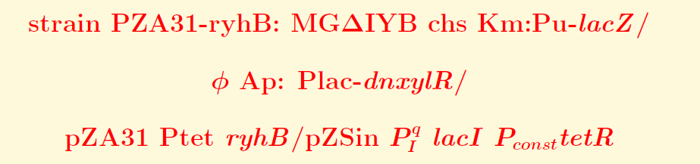
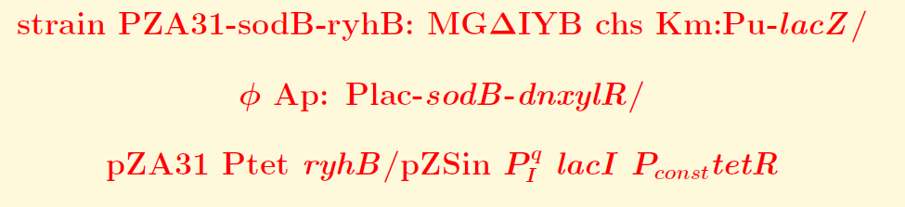
Application on sodB-rhyB circuit
TetR protein represses the Ptet promoter negatively regulated by Tc and aTc.
TetR
Truncated XylR protein activates the Pu promoter with positive regulation.
XylR
More sodB-rhyB ➔ more deletion ➔ less lacZ

Slide 7

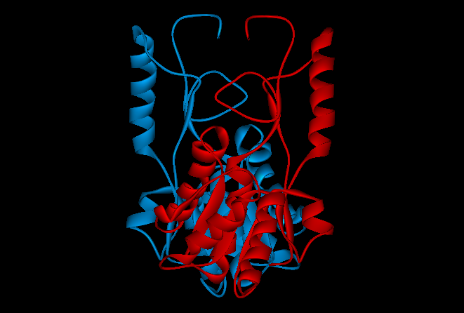
Application on TetR and XylR protein
TetR protein represses the Ptet promoter negatively regulated by Tc and aTc
XylR protein activates the Pu promoter
positive regulation

Slide 8
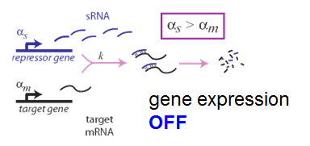
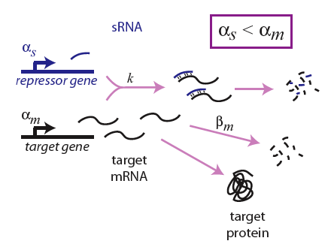
small RNA regulation
Escherichia. Coli K12 MG1655: there are some non-coding small RNAs, like ffs、micF、rnpB、spf、ssrS、dicF、oxyS、dsrA、csrB、sokB、gcvB、rprA、rttB、rhyB and etc. . E. Levine try to use small RNA rhyB and target mRNA sodB as the genetic regulation switch

Slide 9
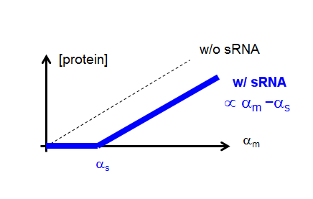
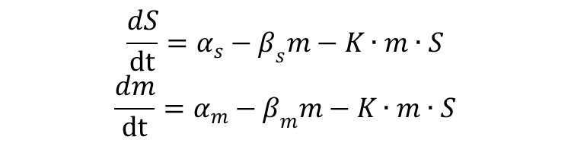
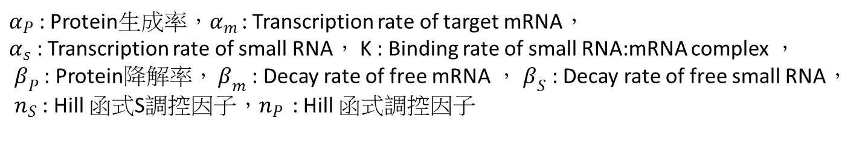
Mean field theory: a dynamic model

Slide 10
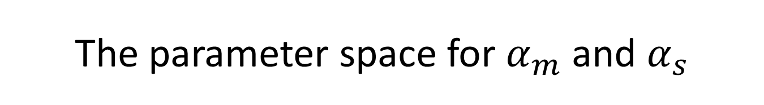
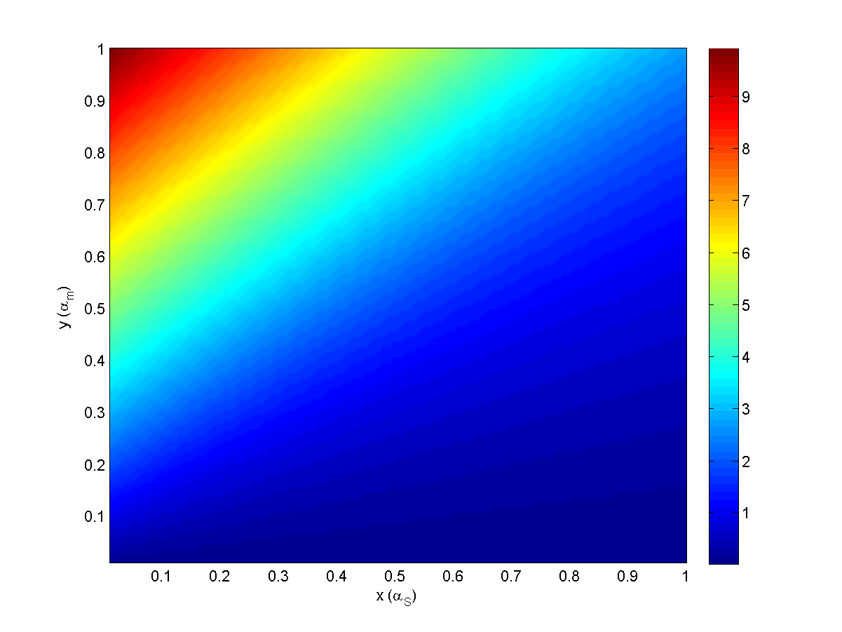

Slide 11
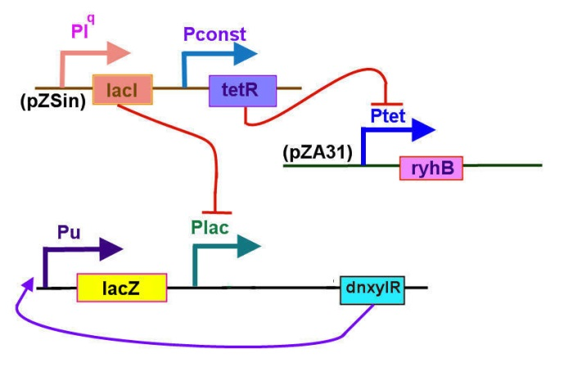
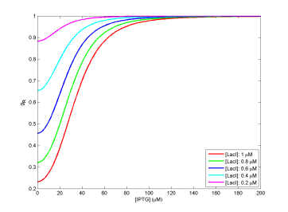
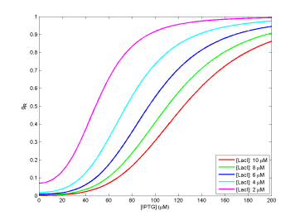
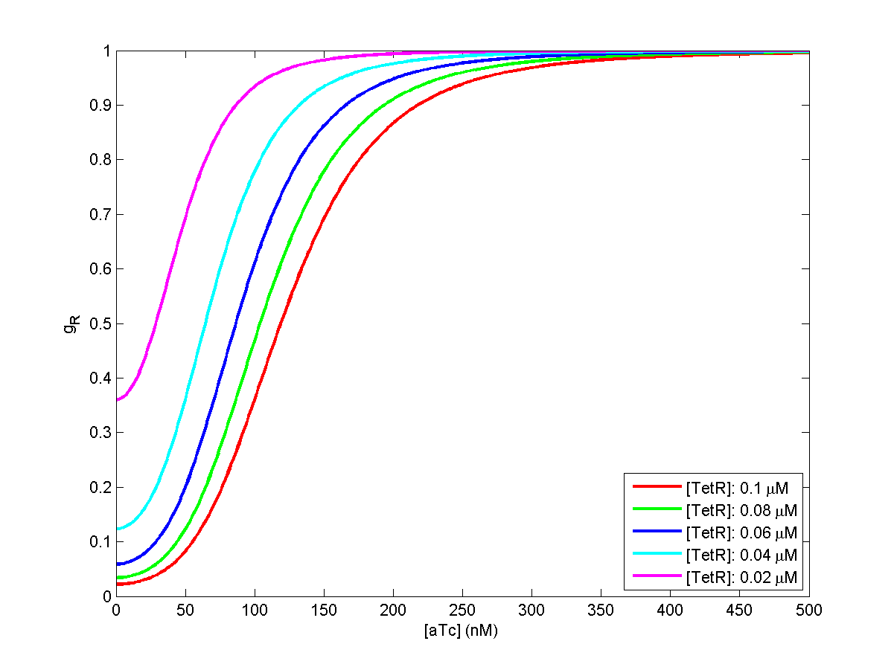
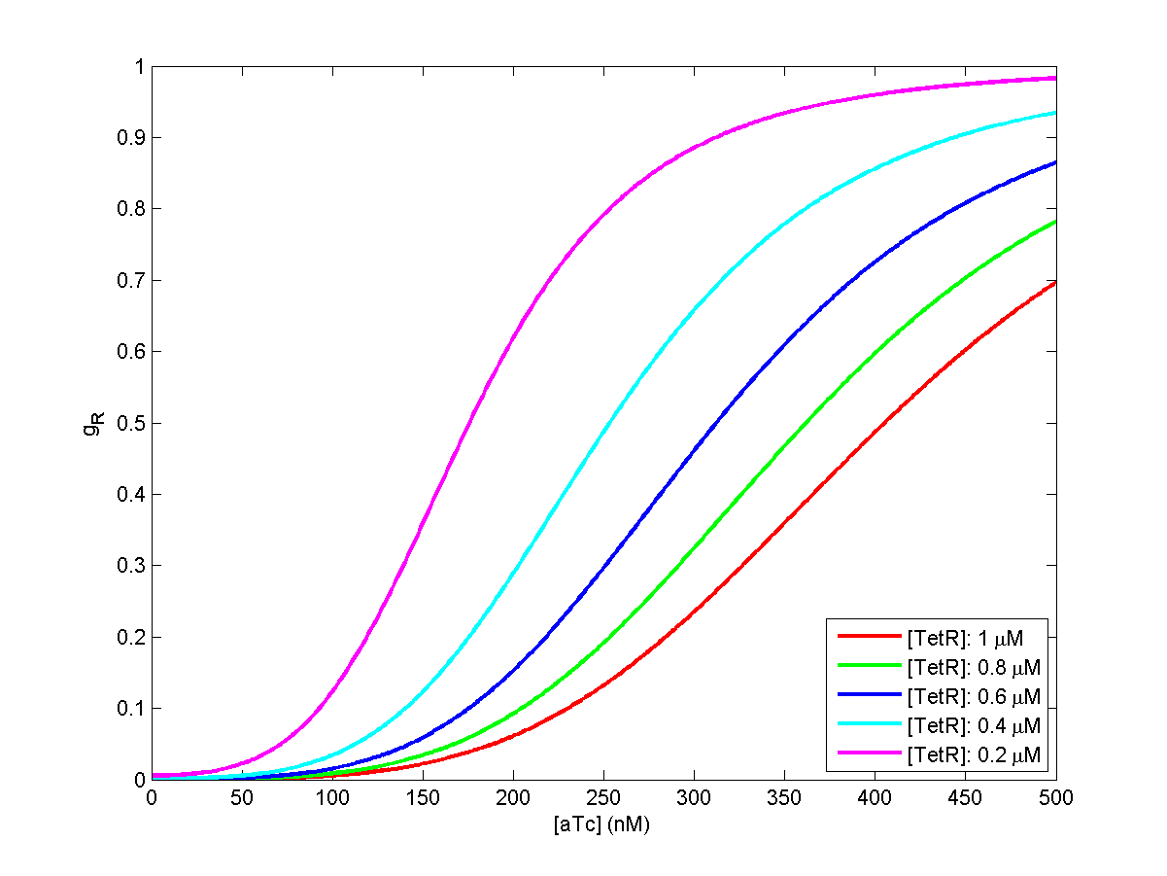
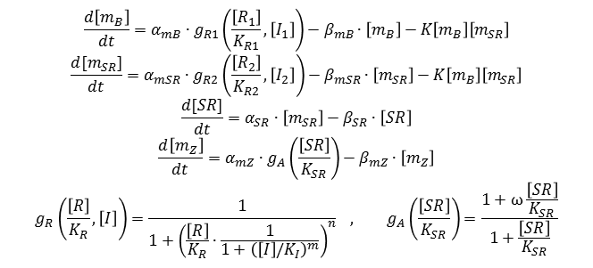
The Synthetic Regulatory Circuit with Small RNA
Only -ryhB
With -ryhB- sodB-
TetR protein represses the Ptet promoter
negatively regulated by Tc and aTc; LacI represses Plac promoter and inducer as IPTG
Truncated XylR protein activates the Pu promoter with positive regulation.
K_{plac-LacI} = 0.55 uM
K_{LacI-IPTG} = 30 uM
K_{pTet-TetR} = 50 nM
K_{pTetR-aTc} =15 nM
a kinetic model
Regulation function
$$\frac{d\left[m_{B}\right]}{dt}=α_{mB}∙g_{R1}\left(\frac{\left[R_{1}\right]}{K_{R1}},\left[I_{1}\right]\right)−β_{mB}∙\left[m_{B}\right]−K\left[m_{B}\right]\left[m_{SR}\right]$$
$$\frac{d[m_{SR}]}{dt}=α_{mSR}∙g_{R2}\left(\frac{\left[R_{2}\right]}{K_{R2}},\left[I_{2}\right]\right)−β_{mSR}∙\left[m_{SR}\right]−K\left[m_{B}\right]\left[m_{SR}\right]$$
$$\frac{d[SR]}{dt}=α_{SR}∙\left[m_{SR}\right]−β_{SR}∙\left[SR\right]$$
$$\frac{d\left[m_{Z}\right]}{dt}=α_{mZ}∙g_{A}\left(\frac{\left[SR\right]}{K_{SR}}\right)−β_{mZ}∙\left[m_{Z}\right]$$
$$g_{R}\left(\frac{\left[R\right]}{K_{R}},\left[I\right]\right)=\frac{1}{1+{\left(\frac{\left[R\right]}{K_{R}}∙\frac{1}{1+{\left(\left[I\right]/K_{I}\right)}^{m}}\right)}^{n}} , g_{A}\left(\frac{\left[SR\right]}{K_{SR}}\right)=\frac{1+ω\frac{\left[SR\right]}{K_{SR}}}{1+\frac{\left[SR\right]}{K_{SR}}}$$
α_{m} : transcription rate ，β : degradation rate，[m] : mRNA，K: binding rate， [R] : repressor，
α_{SR} : translation rate ， g_{R} : regulation function， g_{A} : activation function， [I] : Inducer，[SR] : target protein，K_{R} : [R] dissociation const，ω : fold const.，m or n: Hill const.

Slide 12
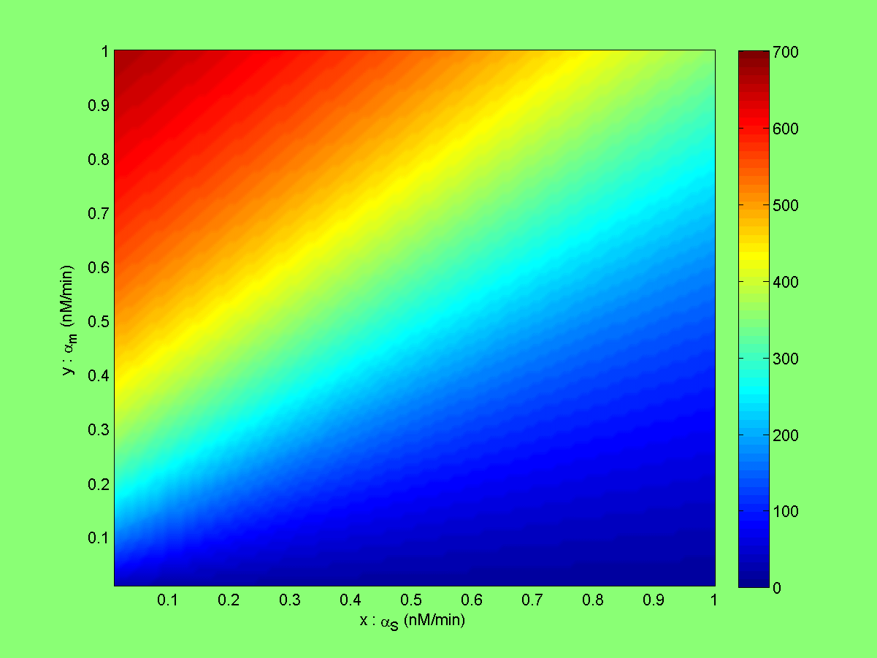
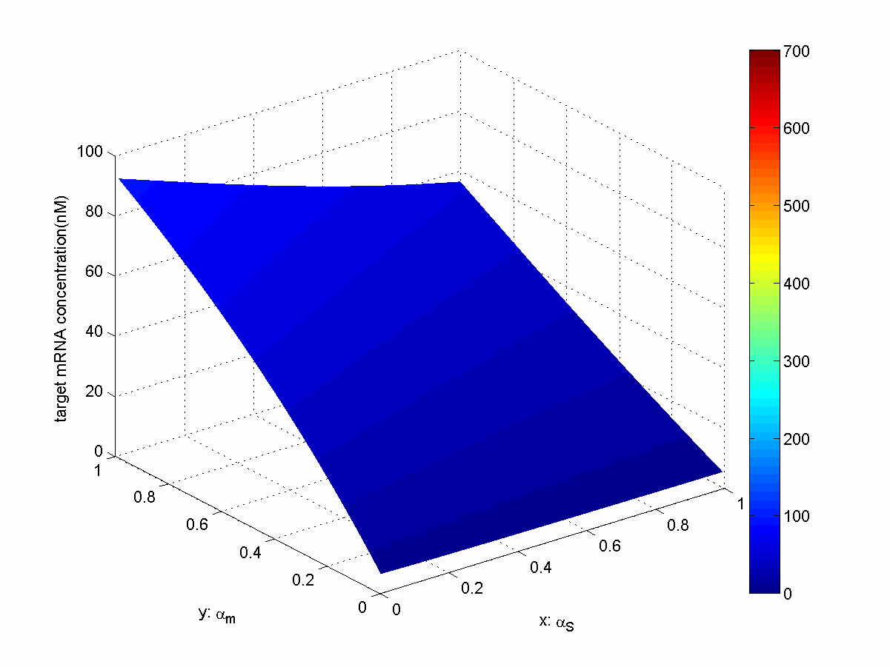
The dynamic variation of target m-RNA concentration
with the various parameters, finally to be the steady state

Slide 13
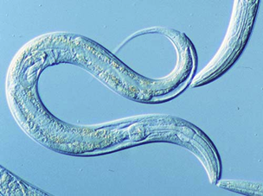
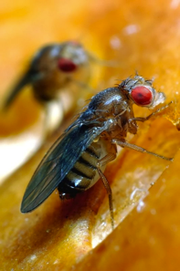
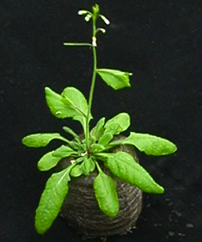
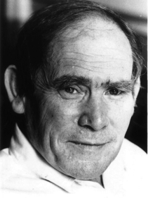
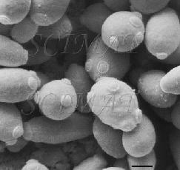
#protein-coding genes ≠cellular complexity
19,000
14,000
~20-25,000
6,000

Slide 14
Long non-coding RNA
80% of the transcription in mammalian genomes is exclusively associated with long non-coding RNAs (lncRNAs)
>2 (some >100) kb in length, spliced and could contain polyA signals
No obvious ORF
Mouse transcriptome (~180,000)
~20,000 protein coding genes
~160,000 lncRNAs

Slide 15
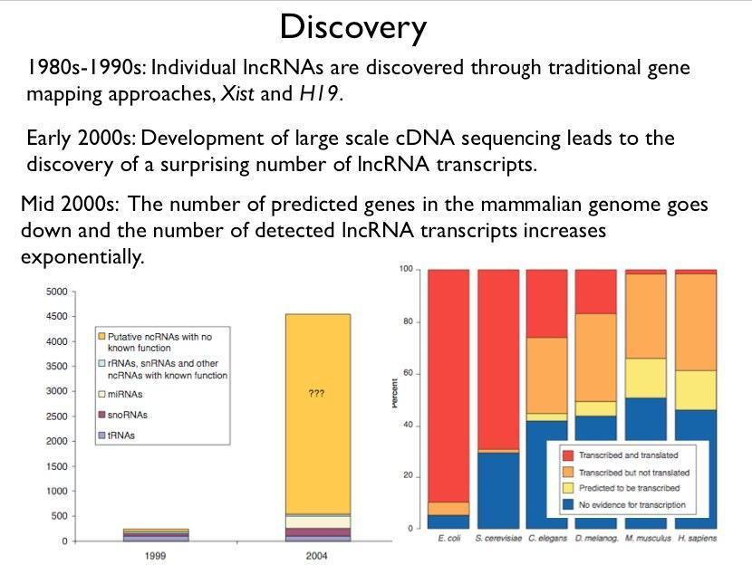

Slide 16
Catagorization
"housekeeping" (tRNA rRNA, RNaseP) vs. Regulatory (H19, Xist)
"high abundance" (Xist, NEAT1) vs. "low abundance" (CCND1)
trans-acting vs cis-acting
loci of origin; sense, antisense, bidirectional, intergenic, totally intronic, partially intronic

Slide 17
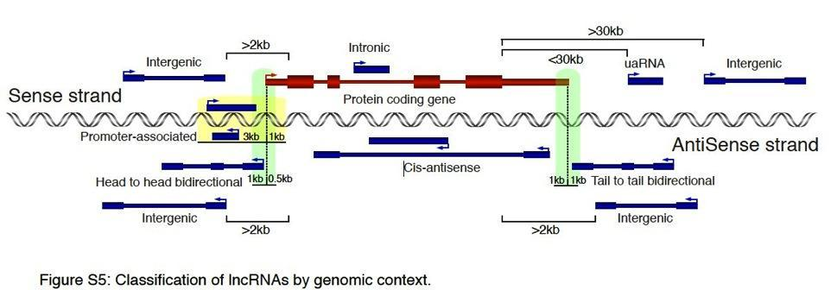
Clark MB. Genome-wide analysis of long noncoding RNA stability. Genome Res. 2012
Notes:
Figure shows different classifications of lncRNAs based on their genomic context. Classifications are based on
locations of lncRNAs compared to known coding genes. Hypothetical protein coding gene shown in red. LncR-
NAs in blue. Arrows show direction of transcription. Thick boxes represent coding exons, medium boxes are
noncoding exons, while thin boxes are introns. Green shaded area at 5’ of coding gene represents region in
which a lncRNA on the opposite strand can initiate and be classified as head to head bidirectional. Green
shaded area at 3’ of coding gene represents region in which a lncRNA can terminate and be classified as tail
to tail bidirectional. Yellow shaded area represents region in which a lncRNA can initiate and terminate and be
classified as promoter-associated. Note that aside from promoter-associated lncRNAs classifications were not
affected by the presence of absence of introns in the lncRNAs. Image not to scale.
Full definitions:
Intergenic transcripts were defined as ncRNAs not transcribed within 2kb upstream of a protein-coding region
on either strand or 30 kb downstream in sense direction or 2kb downstream in antisense direction.
3’UTR-associated transcripts (uaRNAs) were defined as as any ncRNA that initiates within 30 kb downstream
of a stop codon on the same strand (to allow for the potential of 3’UTRs that extend beyond their annotations
(Moucadel et al. 2007; Mercer et al. 2011)).
Head to head transcripts from bidirectional promoters were defined as transcripts that originate from the
antisense strand within 1 kb upstream or 0.5 kb downstream of the 5’ end of another RNA transcriptional start
site.
Tail to tail transcripts terminate on the antisense strand within 1000 nt downstream or 1000 nt overlapping the
termination site of another transcript.
Cis-antisense transcripts were defined as those lncRNAs where at least 90% of their exonic length overlapped
with a transcript on the opposite strand.
Exclusively intronic ncRNAs were defined as those that initiated and terminated within introns of protein-coding
genes in the sense orientation.
Inclusive intronic ncRNAs included any sense noncoding transcript where at least 75% of its exonic region
covers the introns of a protein-coding gene and allowed transcript initiation and/or termination within the coding
gene exons.
Promoter-associated transcripts were defined as single exon transcripts whose transcription was found within
3kb upstream and 1kb downstream of transcription start sites on either strand.
Note 1: Some lncRNA genomic categories are mutually exclusive but others are not.
Note 2: Some lncRNA genomic categories are defined by the distance from a protein coding gene (intergenic,
uaRNA, intronic) while others use the distance from any known transcript (bidirectional, cis-antisense,
promoter-associated)
Mercer TR, Wilhelm D, Dinger ME, Solda G, Korbie DJ, Glazov EA, Truong V, Schwenke M, Simons C, Matthaei KI et al.
2011. Expression of distinct RNAs from 3' untranslated regions. Nucleic Acids Res 39: 2393-2403.
Moucadel V, Lopez F, Ara T, Benech P, Gautheret D. 2007. Beyond the 3' end: experimental validation of extended
transcript isoforms. Nucleic Acids Res 35: 1947-1957.

Slide 18
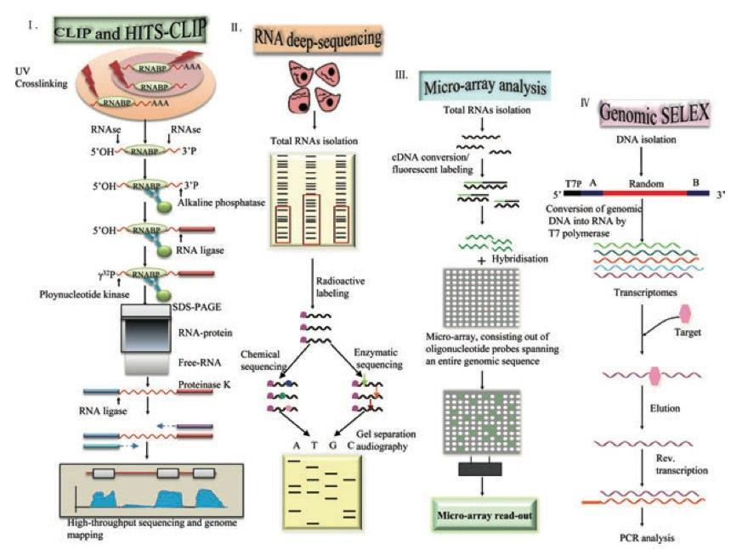
How to detect them?
Li X. Long Noncoding RNAs: Insights from Biological
Features and Functions to Diseases. Med Res Rev. 2012
Notes:
Figure 1. Experimental approaches to identify lncRNAs. A Identification of lncRNAs by high-throughput se- quencing of RNAs isolated by cross-linking immunoprecipitation (HITS-CLIP) methods. Schematic representa- tion of the HITS-CLIP protocol, RNA–protein complexes are covalently cross-linked in vivo using UV irradiation. The protein of interest is purified together with the bound RNA. To allow for sequence-specific priming of reverse transcription, an RNA adapter is ligated to the 3′ end of the RNA, whereas the 5′ end is radioactively labeled (γ32P).Cross-linkedprotein–RNAcomplexesarepurifiedfromfreeRNAusingSDS-PAGE.Afterpurification,pro- teinase K is used to remove the RNA-binding protein (RNABP), followed by linker ligation and RT-PCR to analyze the RNA sequences, using high-throughput sequencing methods. B Identification of lncRNAs by chemical or enzymatic sequencing of extracted abundant RNAs. C Identification of lncRNAs by microarray analysis. DNA oligonucleotides covering the sequence space of an entire genome are spotted onto glass slides, and hybridized to fluorescently labeled samples, derived from cellular RNA. D Identification of lncRNAs by genomic SELEX. By random priming, the genome sequence is converted into short PCR fragments containing a T7 promoter (T7p) at their 5′ region. Subsequently, conversion of genomic DNA into RNA by T7 RNA polymerase can then be assayed for function, such as binding to target proteins, by SELEX.

Slide 19
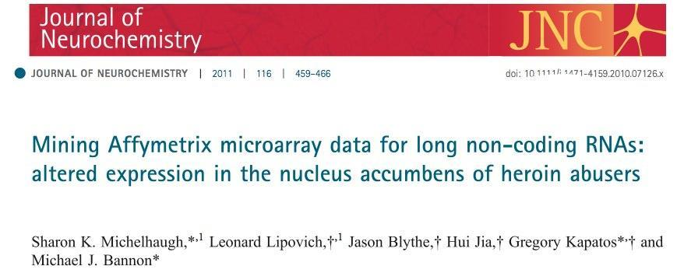

http://www.ebiomed.org/ncFANs/

Slide 20
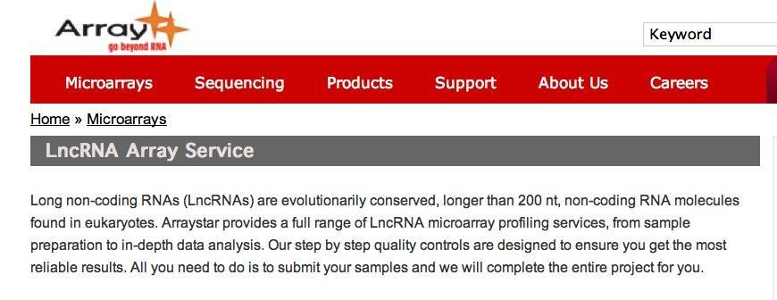
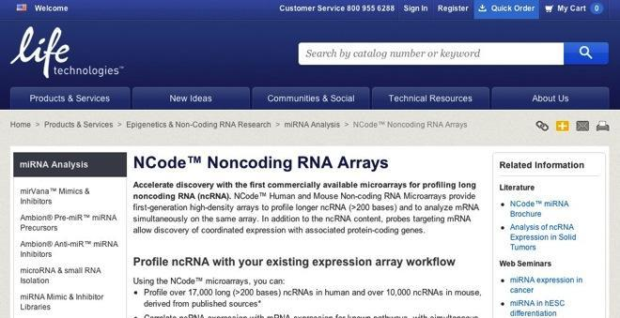

Slide 21
lncRNA Databases
Lncrna db (http://lncrnadb.com/)
FAMTOM3 (http://fantom.gsc.riken.jp/4/)
NONCODE v3.0
ncFANS

Slide 22
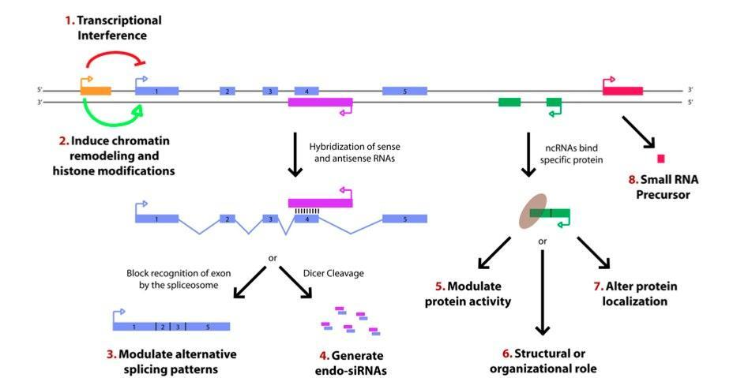
Potential functions of lncRNA
Wilusz JE, Sunwoo H, Spector DL. Long noncoding RNAs: functional surprises from the RNA world. Genes Dev. 2009 23(13):1494-504.
Notes:
Figure 1. Paradigms for how long ncRNAs function. Recent studies have identified a variety of regulatory paradigms for how long ncRNAs function, many of which are highlighted here. Transcription from an upstream noncoding promoter (orange) can negatively (1) or positively (2) affect expression of the downstream gene (blue) by inhibiting RNA polymerase II recruitment or inducing chromatin remodeling, respectively. (3) An antisense transcript (purple) is able to hybridize to the overlapping sense transcript (blue) and block recognition of the splice sites by the spliceosome, thus resulting in an alternatively spliced transcript. (4) Alternatively, hybridization of the sense and antisense transcripts can allow Dicer to generate endogenous siRNAs. By binding to specific protein partners, a noncoding transcript (green) can modulate the activity of the protein (5), serve as a structural component that allows a larger RNA–protein complex to form (6), or alter where the protein localizes in the cell (7). (8) Long ncRNAs (pink) can be processed to yield small RNAs, such as miRNAs, piRNAs, and other less well-characterized classes of small transcripts.

Slide 23
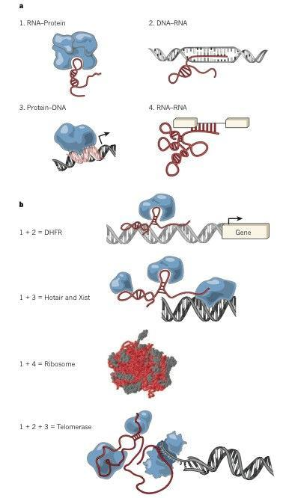
Modular principles of lncRNAs
Guttman M, Rinn JL. Modular regulatory principles of large non coding RNAs. Nature. 2012 482(7385):339-46
Notes:
Figure3|ModularprinciplesoflargencRNAgenes. a,Thefourprinciples of nucleic acid and protein interactions. (1) RNA–protein interactions, (2) DNA–RNA hybridization-based interactions, (3) DNA–protein interactions and (4) RNA–RNA hybridization based interactions. b, Each of these principles can be combined to build distinct complexes. For example, combining RNA– protein and RNA–DNA interactions can localize a protein complex to a specific DNA sequence in an RNA-dependent manner; as has been implicated for the DHFR99 promoter and localization of DNMT3b98. Combining RNA–protein and protein–DNA principles can also localize a diverse set of proteins, which have a molecular scaffold created by RNA, to a specific DNA sequence in a protein-dependent manner. The ribosome is a multifaceted combination
of RNA–protein interactions that facilitate correct RNA–RNA interactions for the ribozyme activity of the ribosome. The telomere replication activity of telomerase is an example of combining RNA–protein, RNA–DNA and protein–DNA interactions.

Slide 24
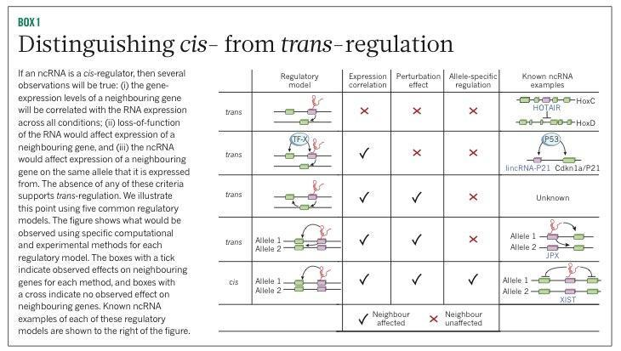
To cis or not to cis

Slide 25
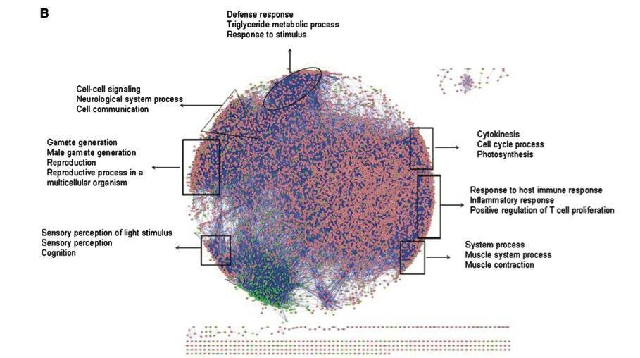
Co-expression network
Liao Q,. Large-scale prediction of long non-coding RNA functions in a coding-non-coding gene co-expression network. Nucleic Acids Res. 2011 May;39(9):3864-78

Slide 26
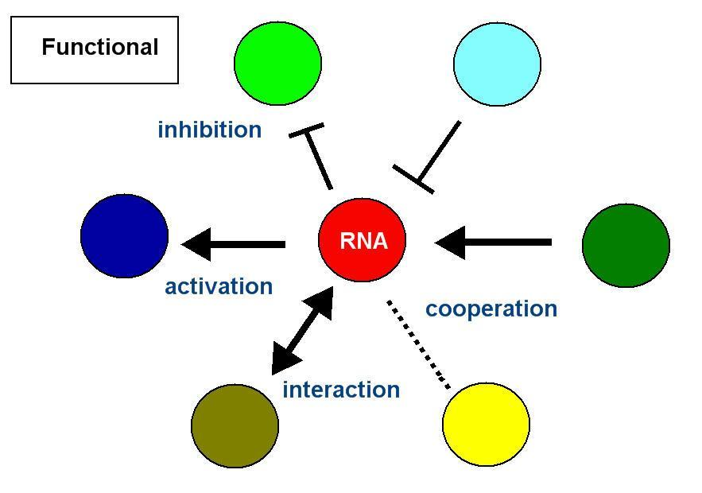
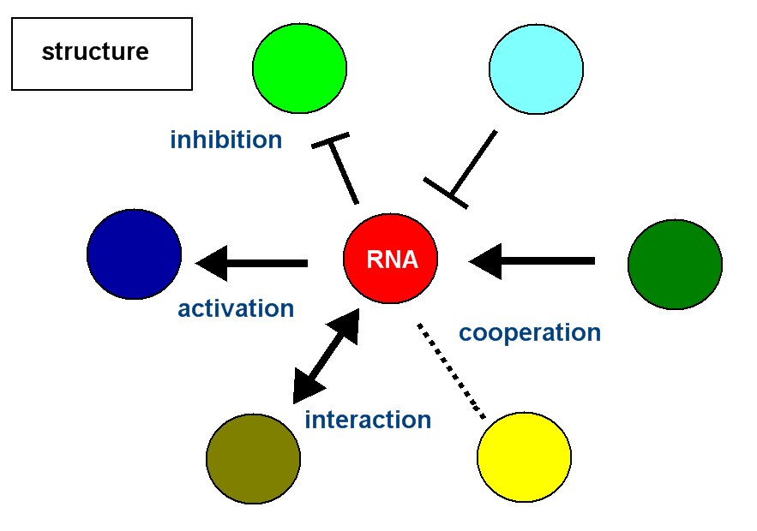

關聯式網絡料庫的 node 建立- - 連結非編碼RNA和IAV感染 (依據 functional, structure, parameter and etc.)

Slide 27
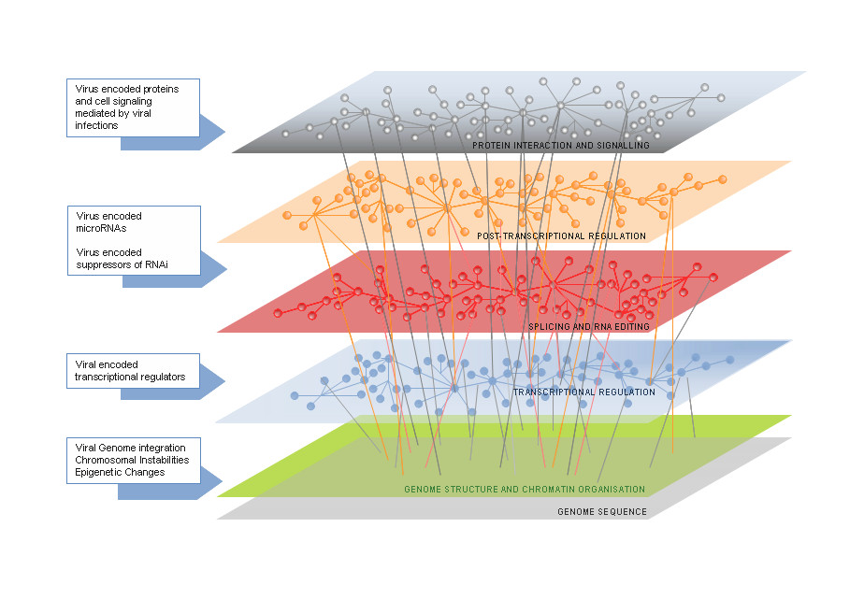
Associated regulation networking
Mean field calculation
Vinod Scaria* and Vaibhav Jadhav, microRNAs in viral oncogenesis, Retrovirology 2007, 4:82

Slide 28
Refer to the bio databases
例如EMBL Database，GenBank， IMGT， dbEST，5S rRNA ，SWISS-PROT， PIR ( Protein Information Resource database)，PDB(Protein data bank)，PROSITE (Database of protein domains, families and functional sites)，ENZYME( Enzyme nomenclature database)，REBASE (The Restriction Enzyme Database)，HSSP( Homology-derived secondary structure of proteins database)，BLOCKS( Protein Blocks Database)，KABAT( Database of Sequences of Proteins of Immunological Interest)，InterPro ，TMBASE( Database of Membrane Spanning Protein Segments)， DICTYDB， EcoGene ( E.coli database collection)，FLYBASE( A Database of Drosophila Genes & Genomes)，MAIZEDB，SGD( Saccharomyces Genome Database)，SUBTILIST(a database dedicated to the analysis of the genome of Bacillus subtilis)，WORMPEP (Caenorhabditis Genome database)，GCRDB(a G-protein-coupled receptor database)，OMIM (Online Mendelian Inheritance in ManTM)，RHDP (The Radiation Hybrid Database)，SWISS-2DPAGE(Two-dimensional polyacrylamide gel electrophoresis database)，

Slide 29
reference
http://compbio.ucdenver.edu/hunter/cpbs7712/documents/Phang_Lab_Talk2_2012small.pptx
Medina RA, García-Sastre A. Influenza A viruses: new research developments. Nat. Rev. Microbiol 9, 590- 603 (2011)
E. Levine, Z. Zhang, T. Kuhlman, and T. Hwa, Quantitative Characteristics of Gene Regulation Mediated by small RNA, PLoS Biol 5: e229 (2007).
Carla Winterling, Manuel Koch, Max Koeppel, Fernando Garcia-Alcalde, Alexander Karlas, Thomas F Meyer, Evidence for a crucial role of a host non-coding RNA in influenza A virus replication, RNA biology, vol 11, issue 1 (2013)
Watanabe T, Watanabe S, Kawaoka Y. Cellular networks involved in the influenza virus life cycle. Cell Host Microbe 7, 427- 39 (2010)
Djebali S, Davis CA, Merkel A, Dobin A, Lassmann T, Mortazavi A, Tanzer A, Lagarde J, Lin W, Schlesinger F, et al. Landscape of transcription in human cells. Nature 489:101 - 8(2012)

Slide 30
指導資優生科展及論文事跡
2000年，指導科展作品第40屆應用科學科全國第一名，邏輯映射串流加密器，台北市中正國中，作者 : 呂任棠、唐維澤、陳毅。
2003〜 2006年，國立編譯館邀請編寫國中自然科學教科書 。
2004年，與陳毅(Chen Yi)發表一篇國際期刊論文，成功推薦陳毅(Chen Yi)進入麻省理工學院就讀，陳毅將於2014年加州理工物理博士畢業，Po-Han Lee, Yi Chen, Soo-Chang Pei and Yih-Yuh Chen, Evidence of the Correlation Between Positive Lyapunov Exponents and Good Chaotic Random Sequences, Computer Physics Communications, Volume 160, Issue 3, pp 187-203, (2004).
2005年，指導陳冠儒同學第四屆旺宏科學獎優等獎，鳥音音頻識技術的電子資料庫建立
2011年，第16屆生物物理大會， The characterization and application of a synthetic autoregulatory circuit 海報競賽優等獎
指導師大附中學生江政穎發表會議論文，Po-Han Lee (李柏翰), Cheng-Ying Chiang (江政穎) and Wan-Sheng Su (蘇萬生), A study of field enhancement factors of closed single-walled carbon nanotubes enhanced by Cs adsorption, Annual Meeting of The Physical Society of Republic of China, 2012. (Conference paper)，江政穎目前為台大醫學系學生。
指導師大附中學生江政穎發表期刊論文，P. H. Lee, C. Y. Chiang, Y. T. Wang , W. J. Lee, and W. S. Su, Effects of Cs adsorption on the field emission characteristics of closed single-walled carbon nanotubes, Journal of Vacuum Science & Technology B, 31(2), 021802-1 (2013)

Slide 31

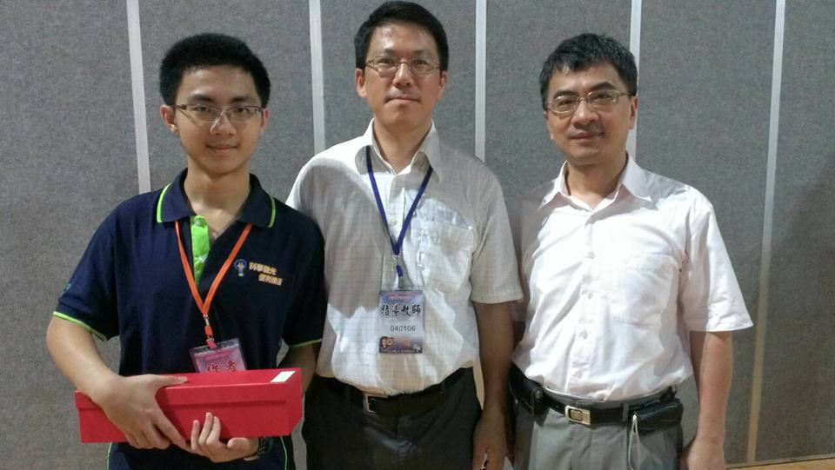
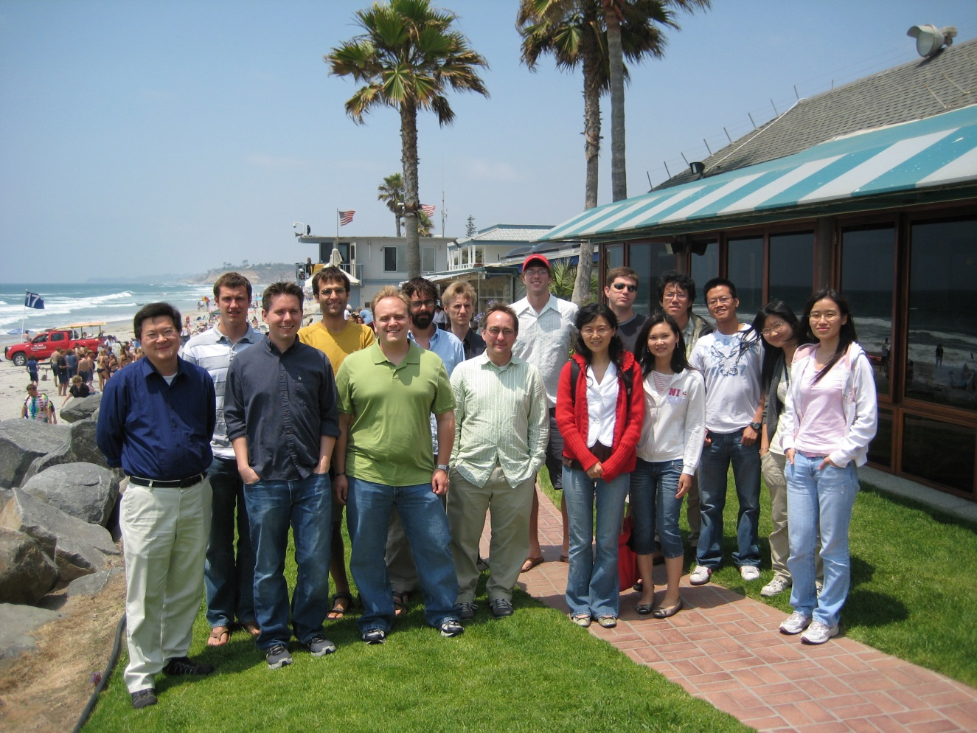
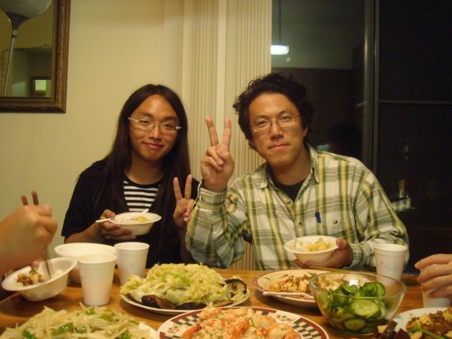
2013年國立師附中全國科展第三名代表領獎
2013年指導國立師附中高瑞璠物理科展全國第三名
2006 Yi Chen 和李柏翰 in UCSD 合作論文
Professor Terence Hwa, Center for Theoretical Biological Physics University of California, San Diego, visiting scholar 2006-2007

Slide 32

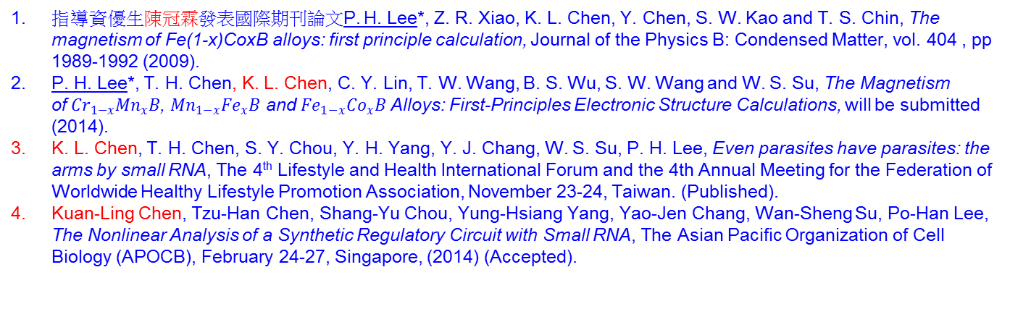
指導資優生 陳冠霖 論文事跡
指導資優生陳冠霖發表國際期刊論文P. H. Lee*, Z. R. Xiao, K. L. Chen, Y. Chen, S. W. Kao and T. S. Chin, The magnetism of Fe(1-x)CoxB alloys: first principle calculation, Journal of the Physics B: Condensed Matter, vol. 404 , pp 1989-1992 (2009).
P. H. Lee*, T. H. Chen, K. L. Chen, C. Y. Lin, T. W. Wang, B. S. Wu, S. W. Wang and W. S. Su, The Magnetism of${Cr}_{1−x}{Mn}_{x}B$, ${Mn}_{1−x}{Fe}_{x}B$ and ${Fe}_{1−x}{Co}_{x}B$ Alloys: First-Principles Electronic Structure Calculations, will be submitted (2014).
K. L. Chen, T. H. Chen, S. Y. Chou, Y. H. Yang, Y. J. Chang, W. S. Su, P. H. Lee, Even parasites have parasites: the arms by small RNA, The 4th Lifestyle and Health International Forum and the 4th Annual Meeting for the Federation of Worldwide Healthy Lifestyle Promotion Association, November 23-24, Taiwan. (Published).
Kuan-Ling Chen, Tzu-Han Chen, Shang-Yu Chou, Yung-Hsiang Yang, Yao-Jen Chang, Wan-Sheng Su, Po-Han Lee, The Nonlinear Analysis of a Synthetic Regulatory Circuit with Small RNA, The Asian Pacific Organization of Cell Biology (APOCB), February 24-27, Singapore, (2014) (Accepted).

Slide 33
執行過計劃
2006.05.01 ~ 2006.12.31, Project Leader, The Theoretic Calculation and Analysis of Nano-material, Ministry of Education, Taiwan
2007.01.12~2008.08.31, Small RNA project, Autoregulation genetic circuits and Nitrogen regulation project, Principal Investigator/Program Director: Hwa, Terence, UCSD, USA 2009.01.01 ~ 20011.12.31, Project Leader, The Theoretic Calculation and Analysis of Nano-material, Ministry of Education, Taiwan
2010.11.24 ~ 20011.07.31, Project Leader, Dilute Magnetic Semiconductor (DMS)第一原理研究計算磁性研究, Ministry of Education, Taiwan
2010.12.29 ~ 20012.10.31, Project Cooperator, 石墨奈米帶之場激發,光學性質與電子傳輸之第一原理研究, National Center of High-Performance Computing, Applied Scientific Computing, Taiwan
2012.09.12 ~ 2013.09.04 磁性材料 TB合金系列(Ｔ=Cr、 Mn、Fe)與 R(Mn1-xFex)2X2 (R=La、Ce、Pr、Nd，X= Si、Ge)相變問題的研究, 100學年度國立臺灣科學教育館與公私立高中職校合作辦理科展專題

Slide 34
科普與科書寫作推廣
並且指導學生錄影，流言追追追深獲好評，推廣科學新知不遺餘力，對推廣科普於高中生有極大的引響力。蛋一微波就會爆炸？流言追追追-【流言現場&校園調查局】，李柏翰教師指導，師大附中1233班演出。
2003〜 2006年，擔任國立編譯館國民中學自然科學教科書編輯委員 。
2009〜 2013年，擔任翰林出版公司高中物理科教科書編輯委員 。
李柏翰, 基因檢測, Newton牛頓科學雜誌 2月號 第64期,FOCUS閱讀P.10 -11(2013)
李柏翰, 人工自我 調控基因開關設計, Newton牛頓科學雜誌 5月號 第67期,特集延伸閱讀P.58 -63(2013)
李柏翰，審定作者, 新基因體革命, Newton牛頓科學雜誌 8月號 第70期, P.46 -64(2013)

